Slide 1


Business Plan
NHC Sports Management Center
May 2020
Business Plan

Slide 2
Contents
Executive summary
NHC Sports Management Center: Our roadmap
NHC Sports Management Center: Key product offering
NHC Sports Management Center app
Haaga-Helia University of Applied Sciences's Lab 8 Suzhou
Haaga-Helia Project: Big Data-Big Business
Haaga-Helia Project: NICCAP - Nordic Innovative Company Creation Acceleration Program
Finnish Sports Town Planning Service Program
Our office allocation and future needs
Three-Year Financial Forecast (RMB Million)
Fund raising
Exit strategy
Our partners
Marketing events in 2018-2020
Founder and CEO Personal profile
Advisors (part)
Contact us

Slide 3
Executive summary
Market background | Beijing Winter Olympic Games is just three years away and winter sports are now worth more than $50 billion. Based on Beijing 2022 figures, there is a 16% YoY increase in 2018 from USD 46.2bn to USD 53.6bn, creating an additional 1.5m jobs. We estimate there is at least an USD 43bn¹ opportunity in winter sports and a gap in the market on enhanced training facilities and technical know-how
Our mission
NHC Sports Management Center (Suzhou) is a Singaporean company based in Suzhou, China, and plans to bring the best winter sports technology and business practices from Finland to China.
What we offer | World class management team with deep expertise in training and entrepreneurship Strategic collaboration and partnerships with Finland’s best winter sports management professionals and trainers 500-sqm office in Dao Valley in Suzhou, with expansion plans to cater in the pipeline to cater for an expanded operations of 1,500 square meters.
1. Based on CAGR of 16% extrapolated based on 2018 growth rate

Slide 4
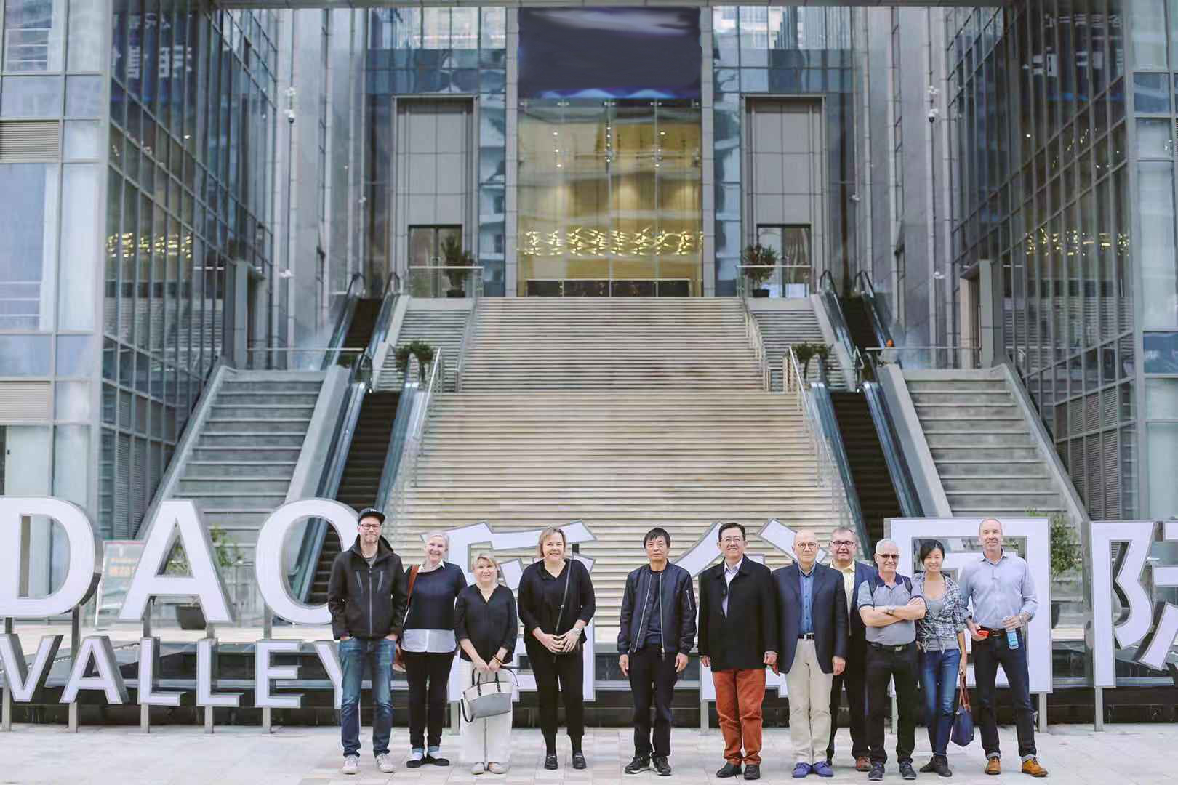
NHC Sports Management Center: Our roadmap
Today
2020-2021
2022 and beyond
Established strategic collaboration and partnerships with Finland’s best winter sports management professionals and trainers
Establish a sports management center in Suzhou with the key offering:
Best-in-class sports management and professional trainers to train Chinese youth in winter sports such as ice hockey
EMBA education in sports management to train Chinese talent in management of sports events and related economic activities
NHC Sports Management Center as industry standard in sports management and education
Continue to innovate and create additional offerings such as:
Winter sport tourism
International Ice Hockey Competition Events
Sports Exchange and Visits
Utilize 5G, AI, AR, Big data into the Ice Hockey Events.
NHC Sports posing with the Finnish partners

Slide 5
NHC Sports Management Center: Key product offering
Organize and facilitate construction and operation of a sports management center
Training and education
Sports exchange and visits
local and international sports competition events
***Utilize 5G, AI, AR, Big data into the Ice Hockey Events.
Planning, training operations and management of Finnish sports towns
NHC Sports Management Center app
Haaga-Helia University of Applied Sciences's Lab 8 Suzhou

Slide 6

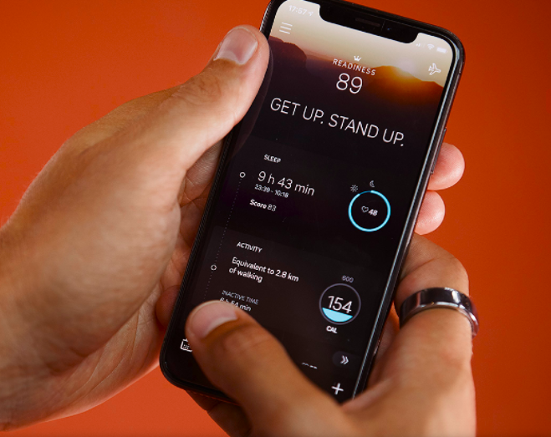




NHC Sports Management Center app
We will work with our partners in both Finland and China to develop an app to link up all stakeholders surrounding the winter sports training facilities and events.
Sponsors / advertisers
Big Data/AI analysis
Coaches / referees
Students / trainees

Slide 7
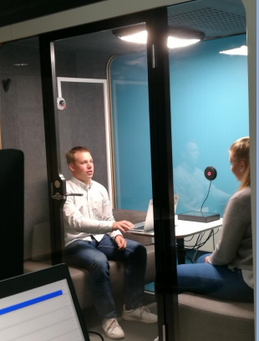

Haaga-Helia University of Applied Sciences's Lab 8 Suzhou
Service Experience Lab
These projects are already in operation in Finland, but are now planned to be introduced to China.
Applications of AR/VR/MR in sports events
SalesLab
buyer-seller interaction analysis)
eComLab
e-commerce analytics
Time | Target
Q2, 2020 | Set up R&D infrastructure in Suzhou: Fitting LAB8 functions & equipment to existing premises. Showroom capability
Q3, 2020 | Pilots with client company: Piloting Augmented Reality, Virtual Reality & Mixed Reality, Emotion AI, Facial Expression Analyses, Eye-tracking, Galvanic Skin Response, Semantic analyses, Speech related analyses
Q4, 2020 | Scale up: Extending RDI co-operation

Slide 8


Haaga-Helia Project: Big Data-Big Business
The purpose of Finland's big data project (2017-2019) is to find market opportunities and space through the collection and analysis of big data in the B2B market, and then set up relevant entrepreneurial projects in a targeted manner.
The implementation of this project relies on a multidisciplinary team: big data researchers, marketing and innovation talent, quantity and quantitative analysts, empirical analysts, and more.
Project Beneifts /output：
This project will improve the level of big data application analysis and help entrepreneurs find new business opportunities in the B2B market.
Help companies improve their sales strategies and sales channels, save costs and improve efficiency.
Status: This project has been operating in Finland for two and a half years, and has about ten strategic partners from universities and research institutions in Finland, Belgium and Germany, and ample working capital. The investor is TEKES of Finland.
6

Slide 9


Haaga-Helia Project: NICCAP - Nordic Innovative Company Creation Acceleration Program
NICCAP:
An innovation curriculum that facilitates accelerated international growth for newly established start-ups by providing networks, contacts, resources and skills,
Comprises of three consecutive multidisciplinary and inter-generational hackathons and idea camps that mix students from the participating countries / organizations with the purpose of creating new cross-border companies and expanding the boundary of the innovation ecosystem,
Project aims:
850 students are exposed to entrepreneurship and challenges in the silver, green and blue economies;
6 new cross-border companies with global potential will be created;
15 existing early stage startups are supported within the program;
6 joint demo days for ecosystem partners are organized during the program;
6 joint hackathon challenges are co-created with ecosystem partners;
Concrete road map with responsibilities and annual schedules for ecosystem engagement is created.

Slide 10

Finnish Sports Town Planning Service Program
We can provide the overall planning and design over a Finnish sports town, including: Finnish Snow and Ice Sports Center, Finnish Cultural Tourism Center, Finnish Education Training Center and Finnish Science and Technology Center.
The Finnish sports town is a collection of ice sports facilities, events, related training, fitness and leisure facilities, as well as health and medical institutions, spas, conference facilities and catering facilities and venues.

Slide 11
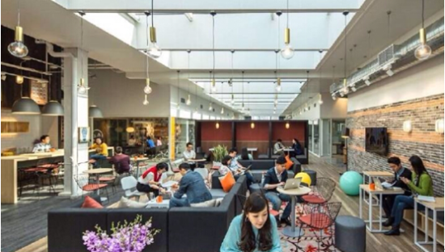
Our office allocation and future needs
Expecting exponential expansion of the operation, such as launching of the Finland Ice Hockey Super League Competition, the Center will in the near future need 1,000 sqm of office space:
  NHC Sports with its games and events management, IT and marketing,
  LAB 8 of Haaga-Helia University of Applied Science,
  Conference rooms of varied sizes, which includes a multi-functional center that is similiar in size and functions to the big lecturing halls of business schools.

Slide 12
Three-Year Financial Forecast (RMB Million)
Item | 2021 | 2022 | 2023
EMBA in Sports Management |  | 5 | 10
Ice Hockey
- Summer/Winter Camp | 2 | 2 | 4
- Coach training | 1 | 1 | 2
- Children and Youth training | 2 | 2 | 4
Sports Exchange and Visits |  | 5 | 10
China Ice Hockey Events |  | 5 | 10
International Ice Hockey Events
- China Finland Ice Hockey events |  |  | 10
- Finland Ice Hockey Super League Competition |  |  | 20
Total Sales | 5 | 20 | 70
PAT (20%) | 1 | 4 | 14
Cumulative PAT | 1 | 5 | 19

Slide 13

Fund Raising
Investment | S$ 2M RMB 10M
No. of investors | 20
Each Unit | S$100，000
Fund | Innovative sports Fund
15

Slide 14
Exit Stategy
Exit Stategy
3+2 years, including 3 years investment period and 2-year exit period
List the project as Innovative Sports Project in Singapore
Sell the company at premium to the listed health care company
List the company at the STIB (Shanghai Exchange's new Science and Technology Innovation Board)

Slide 15

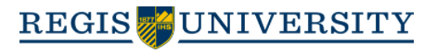

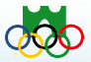
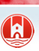

Partners
Haaga-Helia University of Applied Sciences
Regis University
Finland Ice Hockey Association
Suzhou Sports Agency
Suzhou Wujiang District Government
Oppo Group

Slide 16
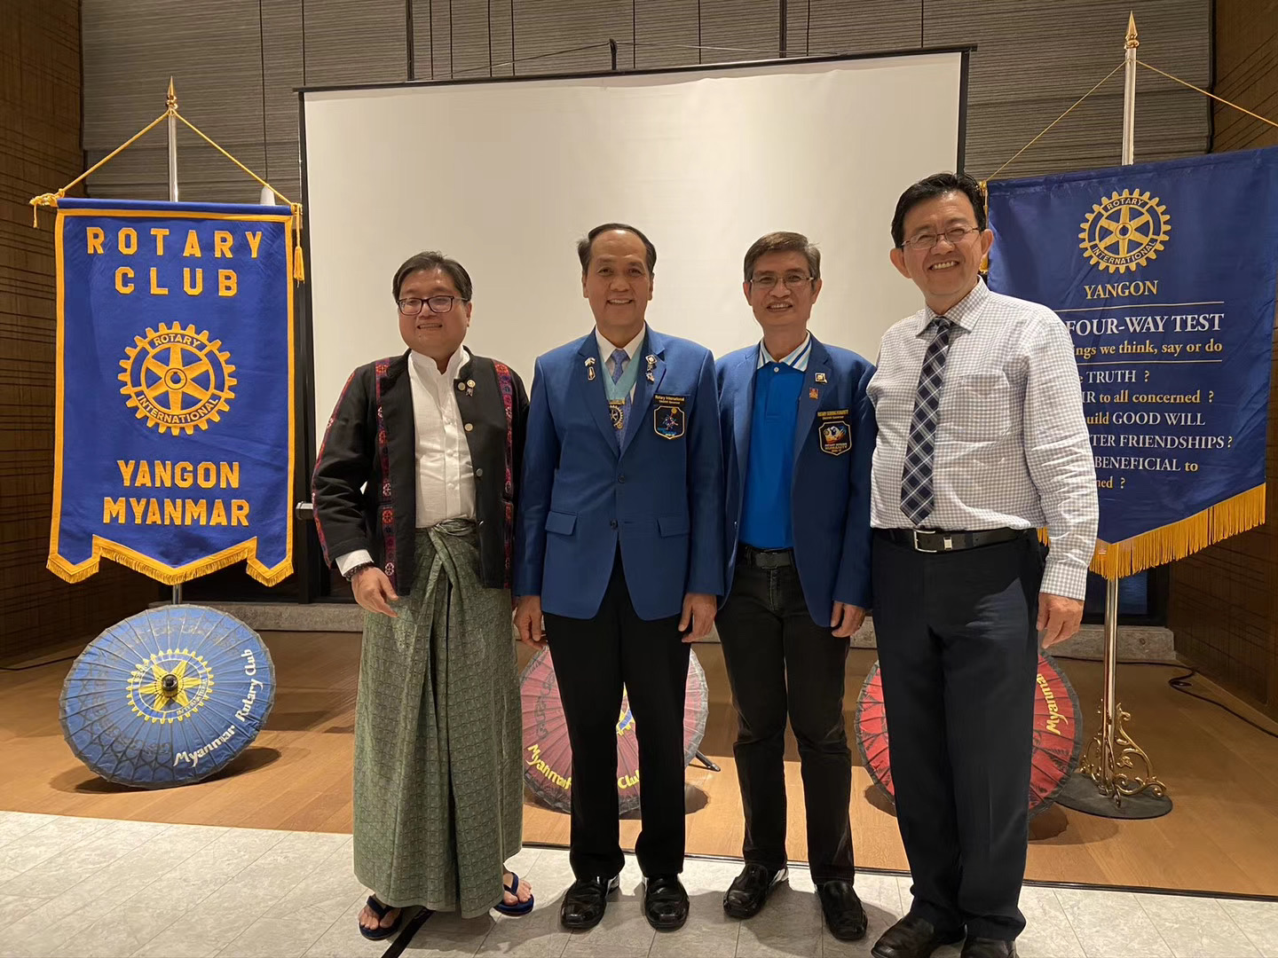
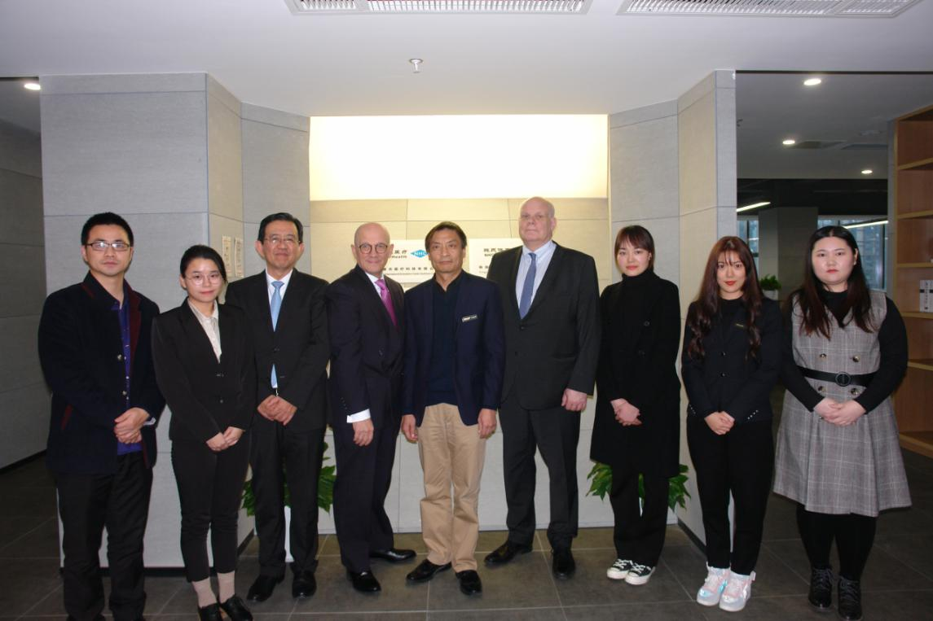
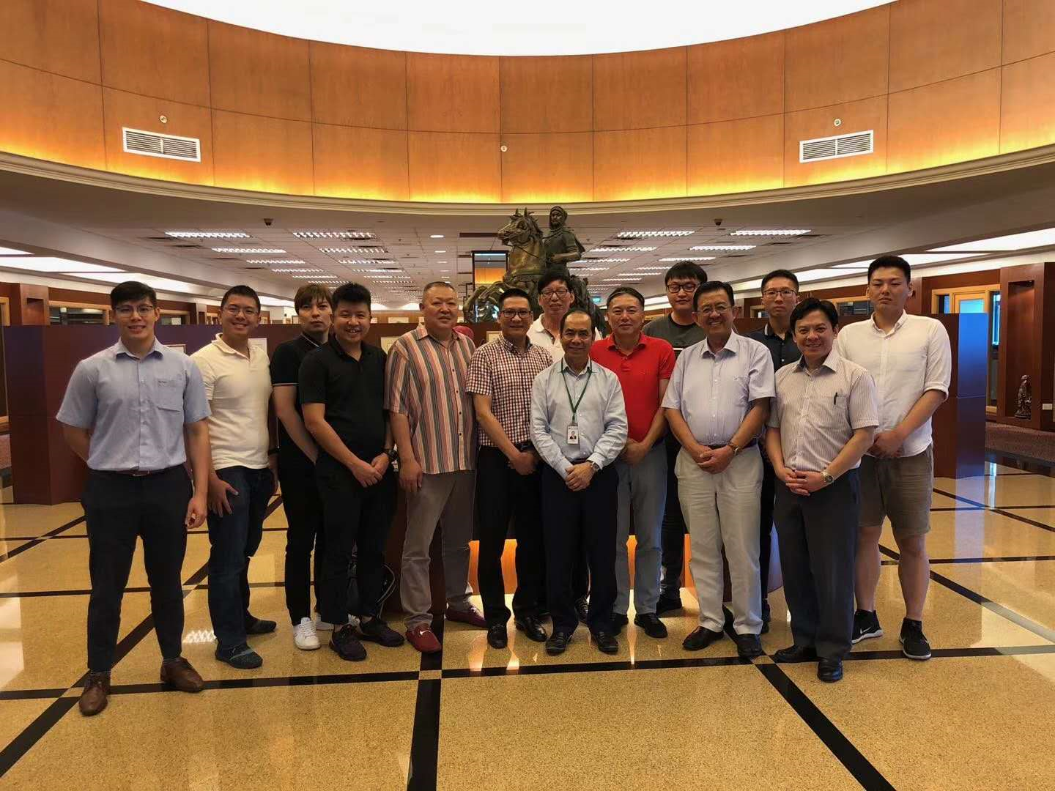
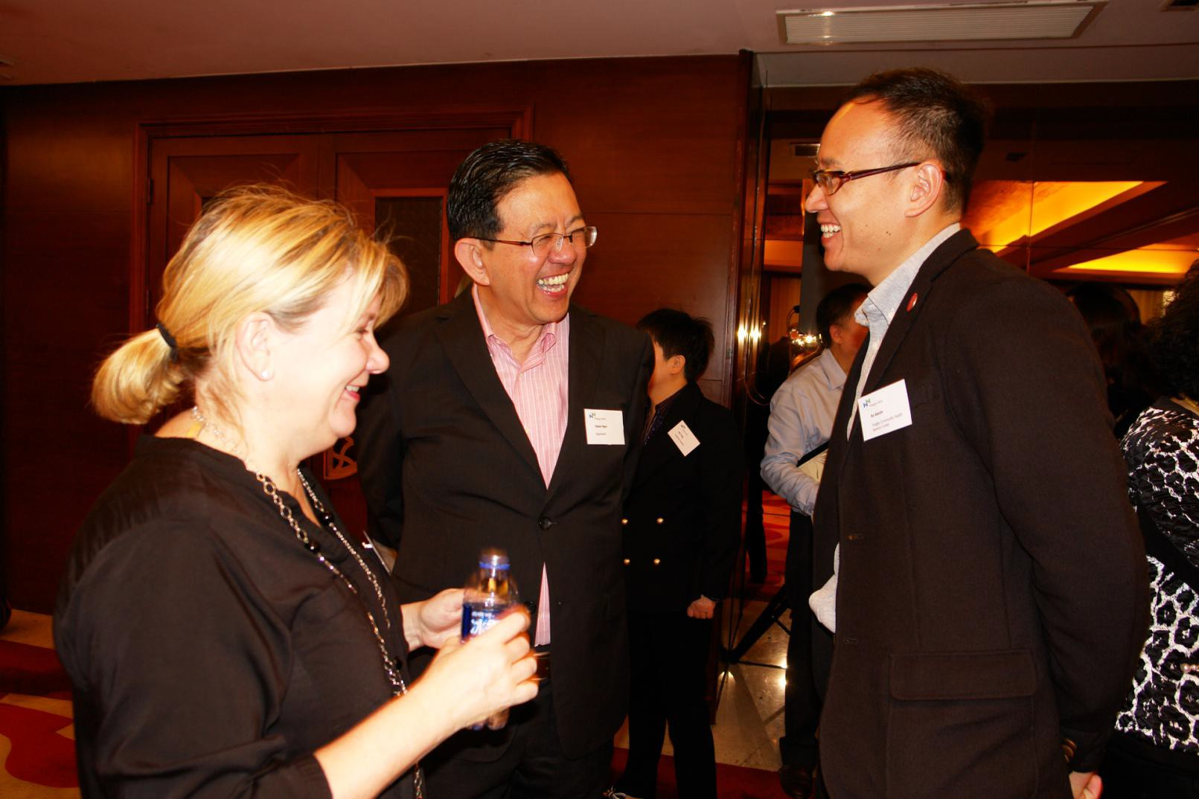
Marketing events in 2018-2020
February 2020, Mr Edwin Ngoi visited Rotary Club and Sithar Coffee Factory in Myanmar to promote the“Coffee for Peace”project.
In December 2019 the opening ceremony of NHC Health International Innovation Center (Suzhou) Co. Ltd .
September 2-7, 2019, Singapore famous businessman, the honor of Goi Family, Founder of TYJ Group and Executive Chairman of GSH Corporation - Sam Goi, invited 15 Goi brothers to visit TYJ factory, GSH Corporate Office, Sutera Harbour Hotel at Sabah and Sabah Mantanani Island.
In July 2019, Mr Edwin Ngoi participated in the Centennial Celebration of Rotary Club of Manila.
In May 2019, Prof. Salvador Aceves, Senior Vice President of Regis University, visited Suzhou and Shanghai to achieve strategic cooperation.
12-13 November 2018，a Sino-Finnish conference on smart cities, health care and elderly care was held in Suzhou. A press release was released on LinkedIn and some other media platforms
October, Mr. Edwin Ngoi was in the U.S. for nearly a month, visiting a number of hospitals and partners to explore opportunities of cooperation in the China market.
24-27 May 2018, the medical school of University of San Fransisco convened a conference that explored MNCs' strategy evolutions in China in the new era.
In May 2018 Haaga-Helia University of Applied Sciences came to Shanghai to meet with prospective partners.
22-25 April 2018 Mr Edwin Ngoi went to Vietnam for a charity event of Rotary International and Roots of Peace.

Slide 17

Founder and CEO Personal profile
Edwin Ngoi is a serial entrepreneur with rich experience in the fields of healthcare, sports and education. He is Founder and CEO of NHC Health International Innovation Center (Suzhou) Co.Ltd, NHC Capital (Shanghai) Co. Ltd. and Venture E (Shanghai) Co. Ltd. He is a member of the Shanghai Singapore Business Association in Shanghai and also a member of the International Education Expert Council of Haaga-Helia University of Applied Sciences in Finland. He enjoys working in philantrophy projects and is a member of the Rotary International. Prior to this, he held senior management positions at multinational companies such as Teradyne Singapore, BHP Lysaght Taiwan and China (Carrier, Whirlpool, Sara Lee and Lion Nathan China) and Singapore Tee Yih Jia (Baoding) Dairy Food. He holds an EMBA from the University of San Francisco, an MBA from the University of Texas at Arlington, and a BBA in MIS from Idaho State University.
13

Slide 18
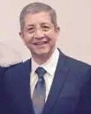
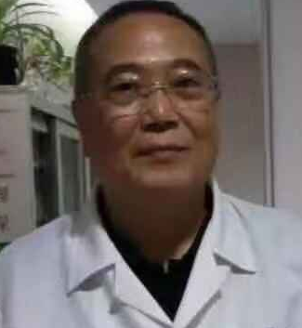
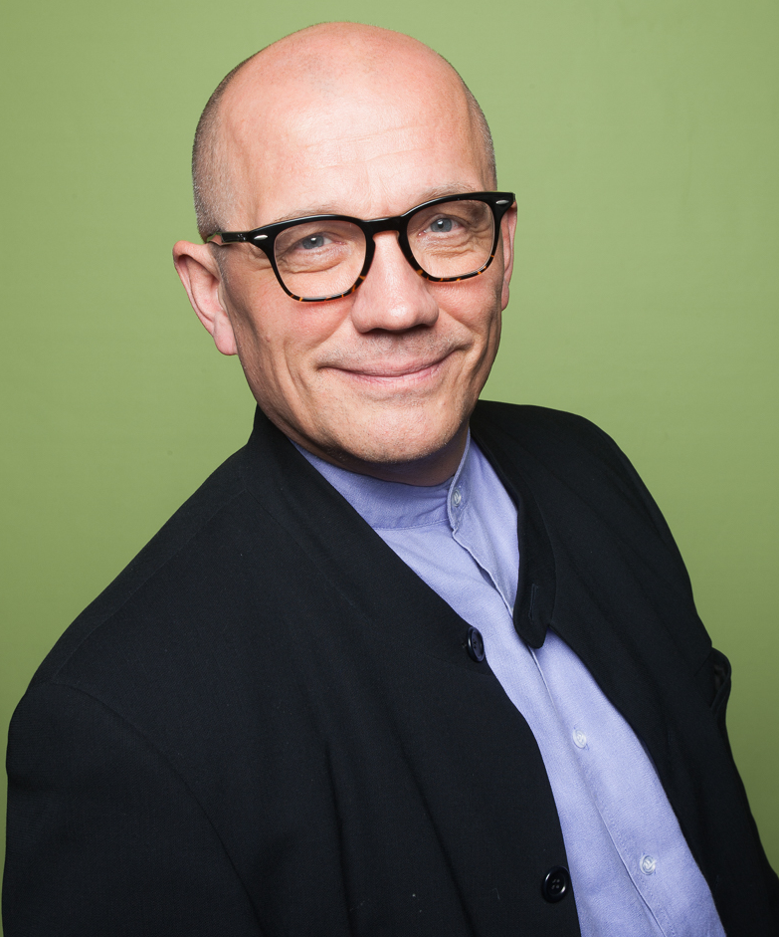
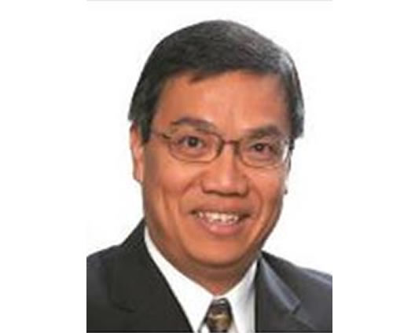
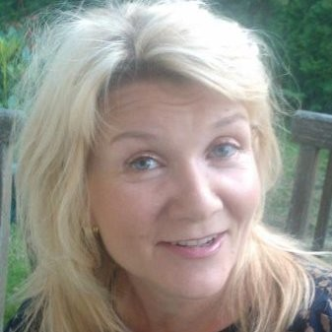
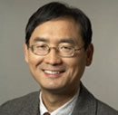
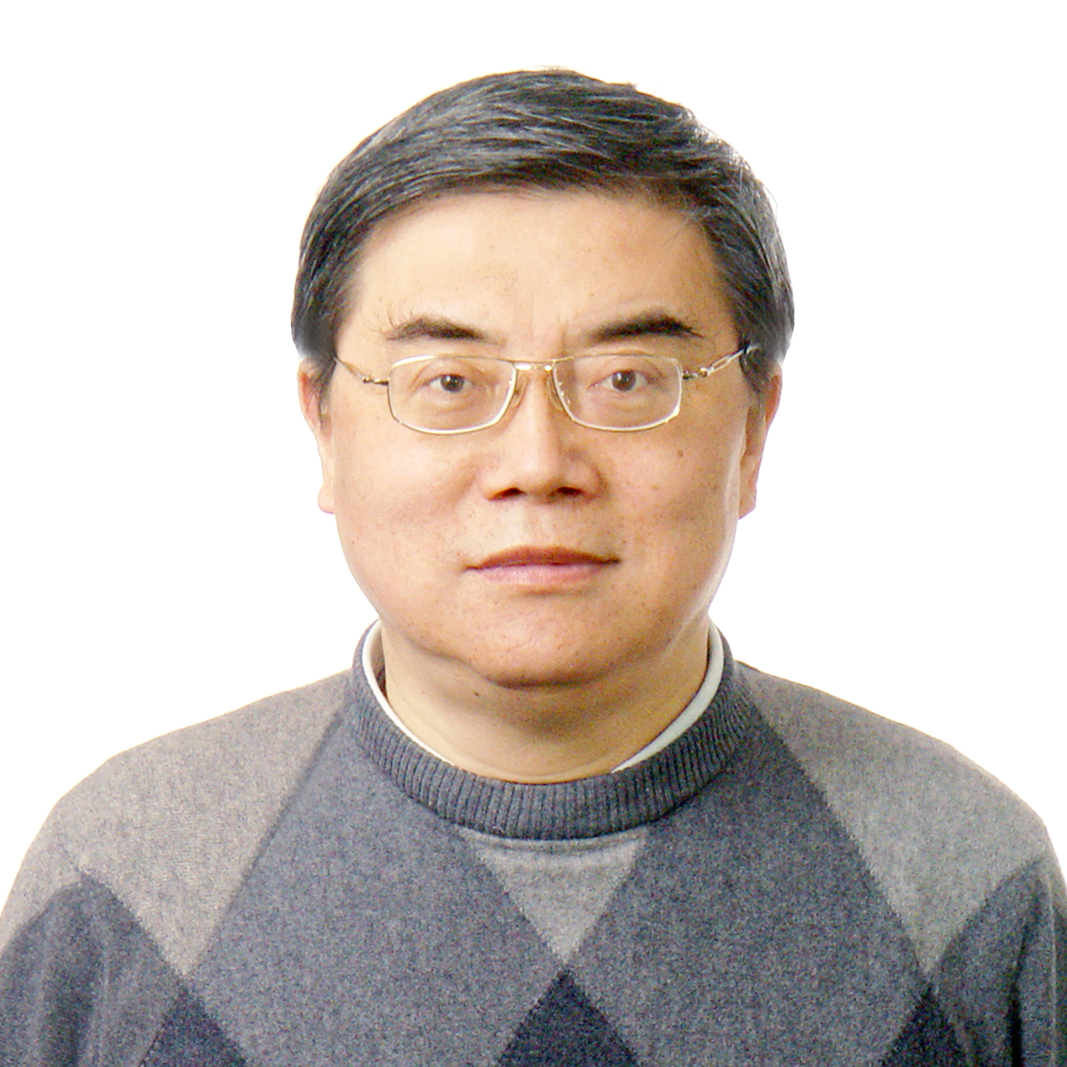
Advisors (part)
Salvador Aceves, Senior Vice-president and CFO at Regis University, USA. Formerly he was Vice-Provost with Fordham University and Vice-Provost with the University of San Francisco.
Tseng Cheng Hui, founder and former CEO of United World Chinese Bank, Former Vice-President of the Shanghai Ruidong Hospital.
MBA of Taiwan University and Master of Law of Chinese Culture University.
Pasi Halmari, Haaga-Helia University of Applied Sciences, has over three decades of experiences of higher education in Finland and elsewhere.
Dr. Ngoi Sing Shang, a renowned Consultant General Surgeon and Consultant Laparoscopic Surgeon at Gleneagle Hospital and Mount Elizabeth Hospital in Singapore, where he has his private practice.
Roger Chen, Professor in Strategy, University of San Francisco, USA.
He has advised Intel, Caterpillar, Tyco Electronics, etc. He holds a PhD in Strategy form the University of Texas at Dallas.
Tiina Laiho, Head of services and comms at CLIC Innovation Ltd & Innoboost Manager of Haaga-Helia University of Applied Sciences.
Li Naihe, Chief Data Scientist of NHC Sports. He's an associate professor at Shanghai Jiaotong University and an expert on big data and AI

Slide 19
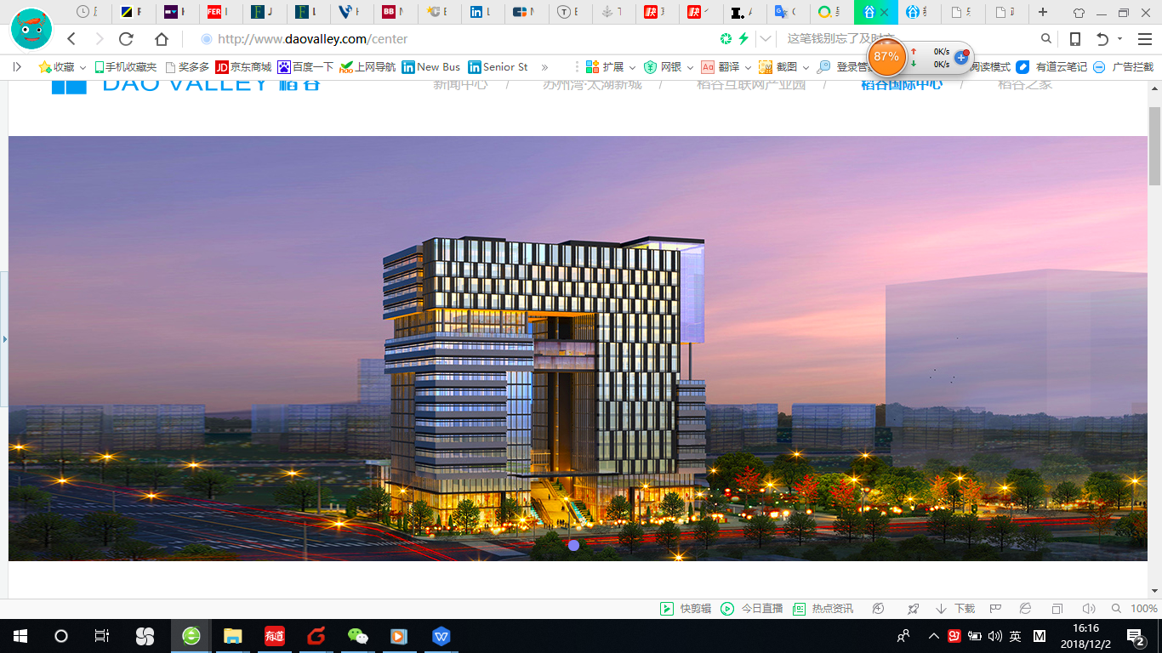
Contact us
Edwin Ngoi
Founder/CEO
NHC Sports Management Center
NHC Health International Innovation Center （Suzhou）Co. Ltd.
Tel： 0512-63168716
0512-63168711
Website: www.nhcsports.cn
Email: edwinngoi@NHCsports.cn
Unit 1704, Dao Valley, No. 500, Shui
Xiu Road, Wujiang District, Suzhou 215200

